Slide 1



Chronic Kidney Disease Detection: A Machine Learning Model
Leveraging Machine Learning Algorithms for Accurate Diagnosis
Presented By:
Divyesh
Aswan
Aejaz
Manik

Slide 2
Chronical Kidney Disease
What is CKD?
Chronic Kidney Disease (CKD) is a long-term disease where the human kidney progressively lose its ability to function properly.
Primarily caused by diabetes, hypertension, and genetic factors.
CKD can lead to kidney failure, requiring dialysis or a transplant if not managed early.
Affects millions worldwide and is a leading cause of morbidity and mortality.

Slide 3

Algorithm-1
Logical Regression

Slide 4

Overview
Logistic regression model for detection of (CKD)
Workflow:
Data Preprocessing
Feature Selection
Model Training
Hyperparameter Tuning
Evaluation and Deployment

Slide 5
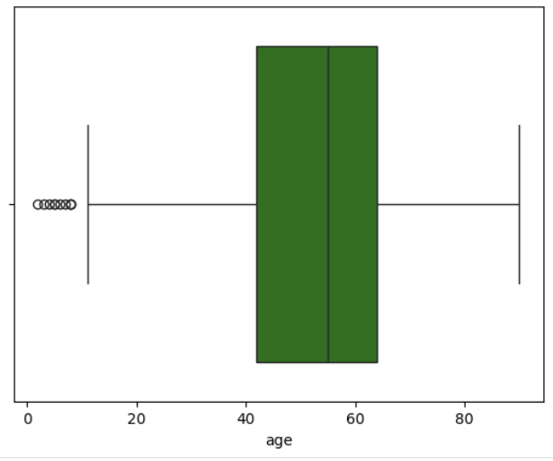
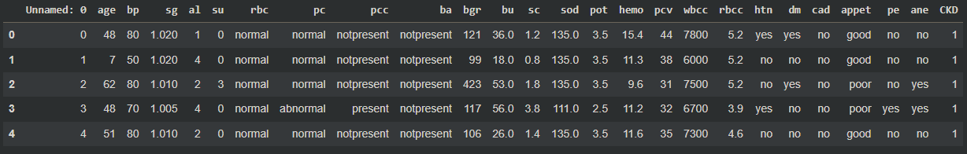
Data Preprocessing
Dataset
Data Cleaning
The dataset used for this model retrieved from [ UC Irvine Machine Learning Repository ]
Removed redundant column and handled missing values.
Encoded categorical features using LabelEncoder.
Handled outliers in numerical features using the IQR method.

Slide 6

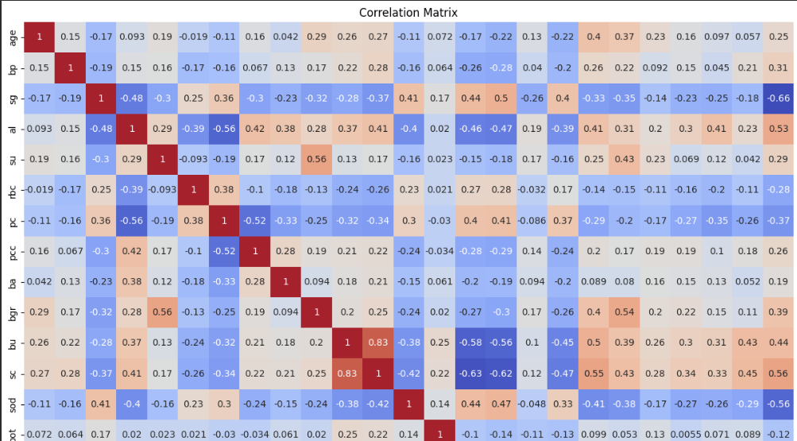

Feature Selection and Model Building
Feature Selection
Based on correlation values ≥ 0.29 with CKD.
Model: Logistic Regression
Baseline model trained with limited iterations (max_iter=10).
Tuned model using GridSearchCV for optimal C value.

Slide 7
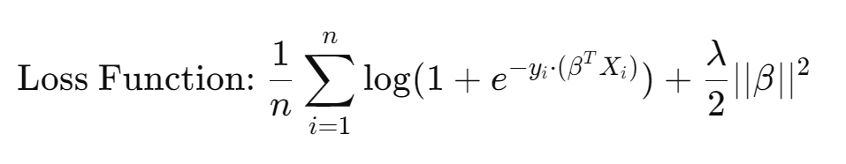
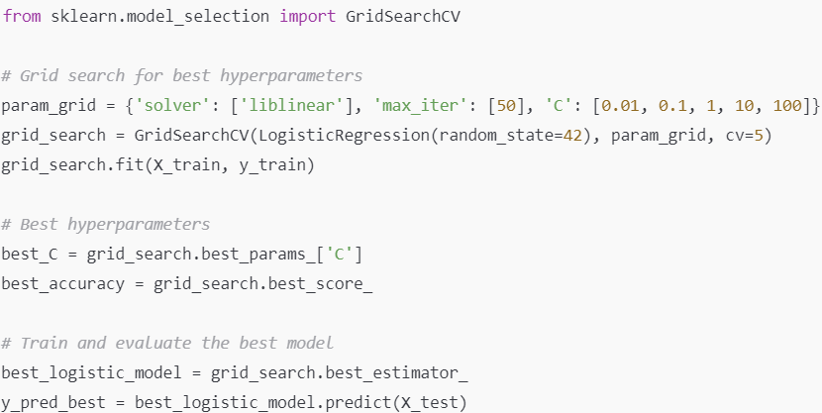
Hyperparameter Tuning
GridSearchCV
The hyperparameter C regulates the inverse of regularization strength, controlling the model's complexity and ability to generalize.
Multiple values of C were tested using GridSearchCV to identify the optimal regularization strength for the model.
The balance between underfitting and overfitting is achieved by selecting the best C value, ensuring improved performance on unseen data.

Slide 8
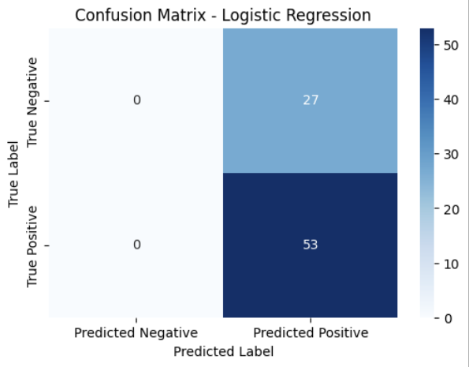
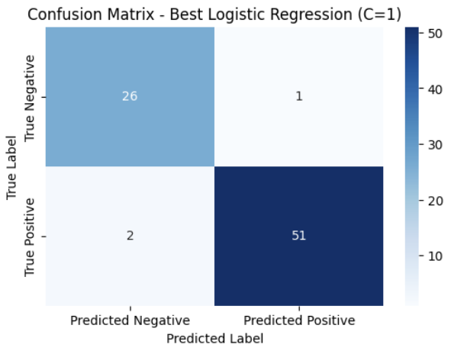
Model Performance
VS
Baseline Model Accuracy
Tuned Model Accuracy

Slide 9
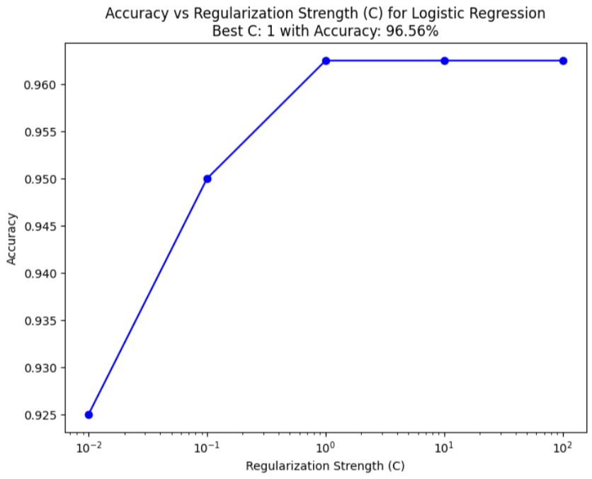
Accuracy vs. Regularization Strength
Regularization Strength (C): Low C values increase regularization, reducing overfitting but lowering accuracy. High C values reduce regularization, improving fit but risking overfitting.
Optimal C: The best C value found is {best_C}, achieving the highest cross-validation accuracy.
Trend Observation: Accuracy initially improves with increasing C, peaks at the optimal value, and then stabilizes or declines due to overfitting.
Deployment Insight: Using the optimal C ensures the model balances accuracy and generalizability.

Slide 10
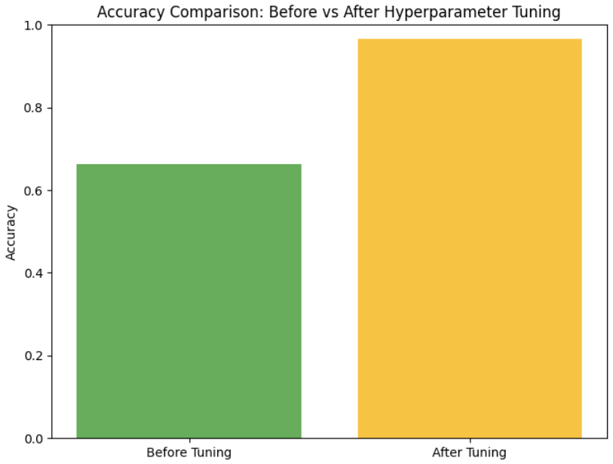
Key Outcomes and Conclusion
Methodology
Achieved improved accuracy after hyperparameter tuning.
Saved the model for deployment (best_logistic_model.pkl).
The tuned model offers robust predictions for CKD detection.
Future Scope
Integrate additional features and test on a larger dataset.

Slide 11
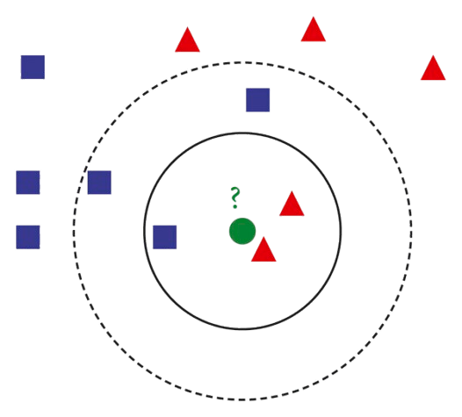
Algorithm-2
K-Nearest Neighbors (KNN)

Slide 12
K-Nearest Neighbors (KNN) Analysis CKD Dataset
Introduction to KNN
Dataset Overview
K-Nearest Neighbors (KNN) is a supervised machine learning algorithm.
It classifies data points based on the majority class of their nearest neighbors.
Used for both classification and regression tasks.
Here, KNN is applied to analyze the CKD dataset.
Dataset: CKD (Chronic Kidney Disease)
Contains attributes related to kidney disease diagnosis.
Data used to train the KNN algorithm to predict outcomes.

Slide 13
K-Nearest Neighbors (KNN): Methodology and Implementation
Methodology
Implementation
KNN uses the distance between data points to find the k-nearest neighbors to a new data point, and predicts its class based on the majority class of its neighbors.
KNN is implemented by calculating the distance between data points and identifying the nearest neighbors based on a chosen metric, such as Euclidean distance.

Slide 14
WORK FLOW
1. Load and preprocesses the dataset
2. Split the data into training and test sets
3. Train the KNN Model
4. Evaluate the model with accuracy and confusion matrix
5. Plot the accuracy for varying k values

Slide 15
KNN Model Implementation
1. Data Preprocessing:
- Handled missing values.
- Scaled the features for uniformity.
-Normalizes the data using Standard Scaler.
2. Model Training:
- Split data into 70% training and 30% testing sets.
- Trained the model using different 'k' values.
3. Model Evaluation:
- Computes the accuracy score.
- Displays a confusion matrix.

Slide 16
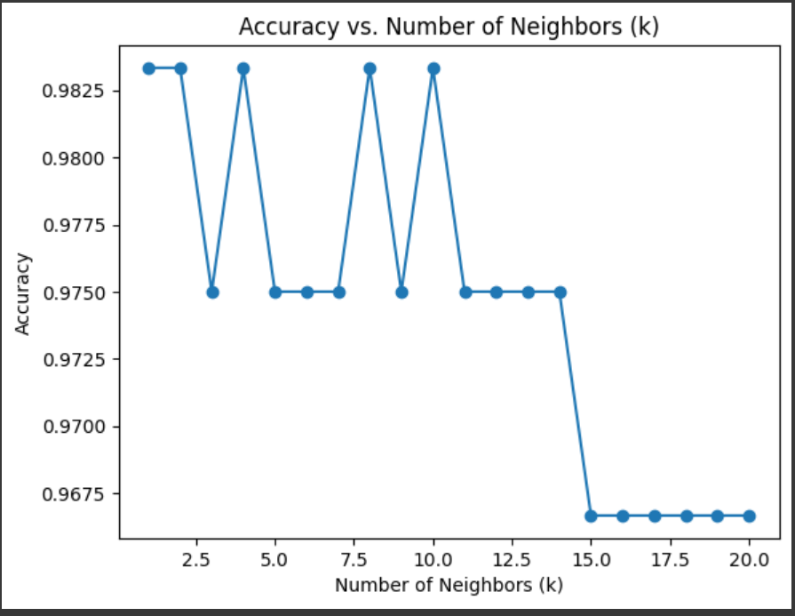
Accuracy vs. Number of Neighbors (k)
The accuracy of the model was evaluated for different values of k (number of neighbors)
Observations:
-The accuracy fluctuates for small values of k, peaking at k=1,5,9,11 .
-Beyond k=15, the accuracy drops significantly.
-Optimal k value appears to be 1 or 9 for highest accuracy .

Slide 17
Classification Report
 | Precision | Recall | F1-score
0 | 1.00 | 0.91 | 0.93
1 | 0.87 | 1.00 | 0.91
Accuracy: 0.92

Slide 18
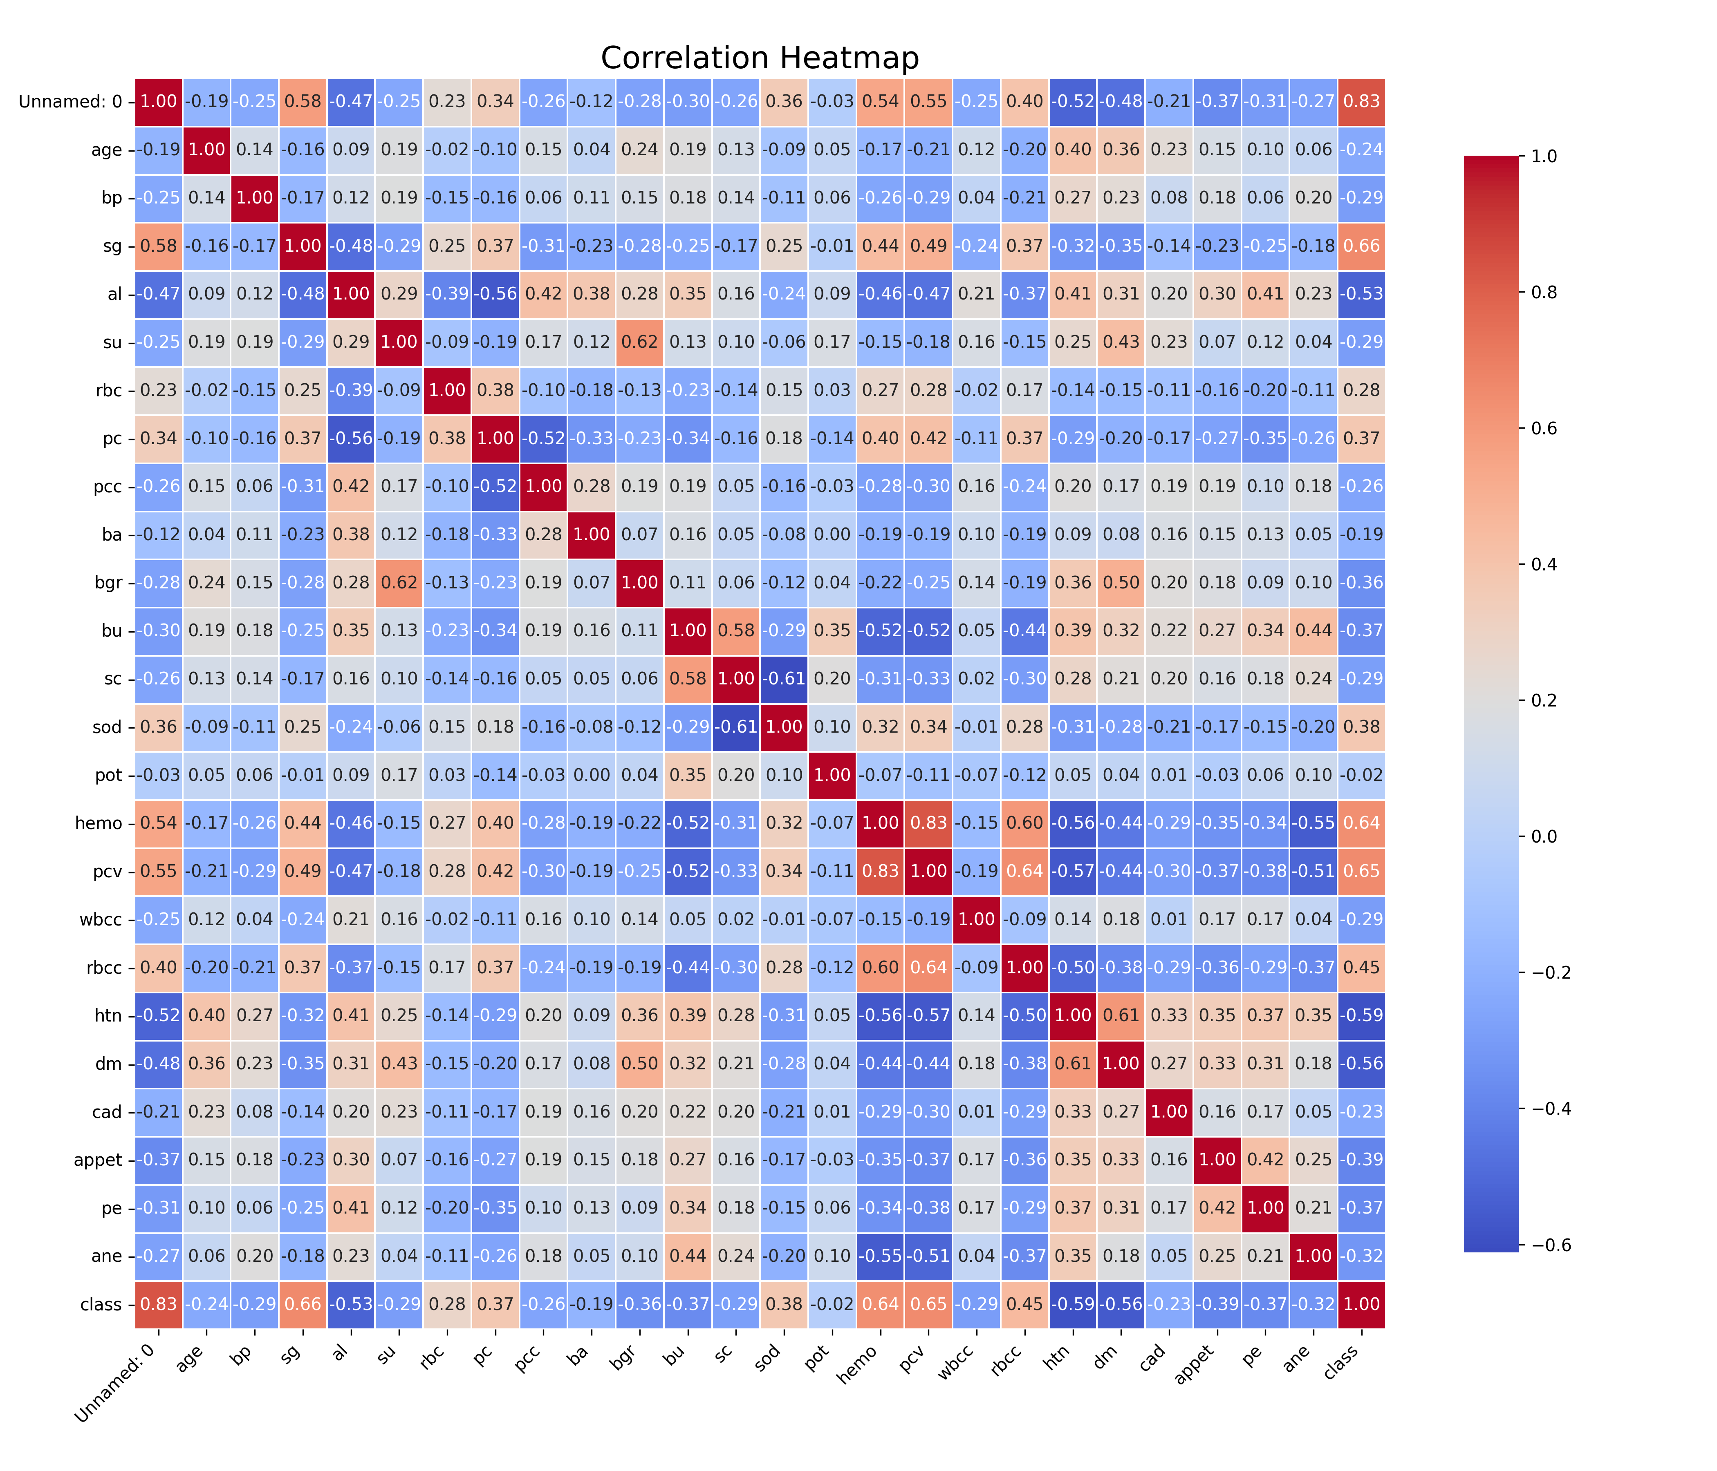
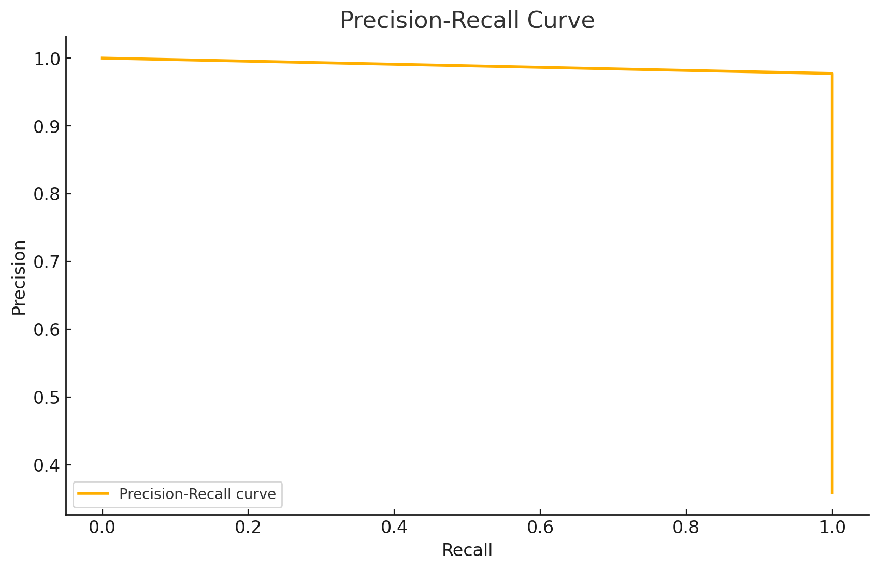
Model Performance
Correlation Heatmap
Precision-Recall Curve

Slide 19
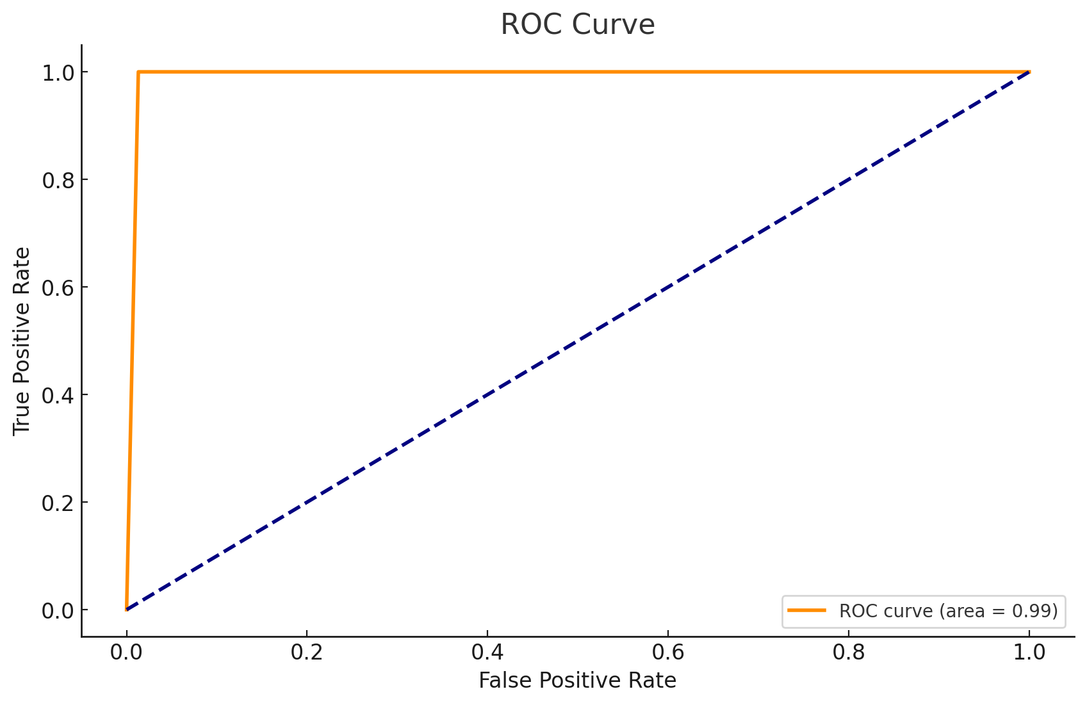
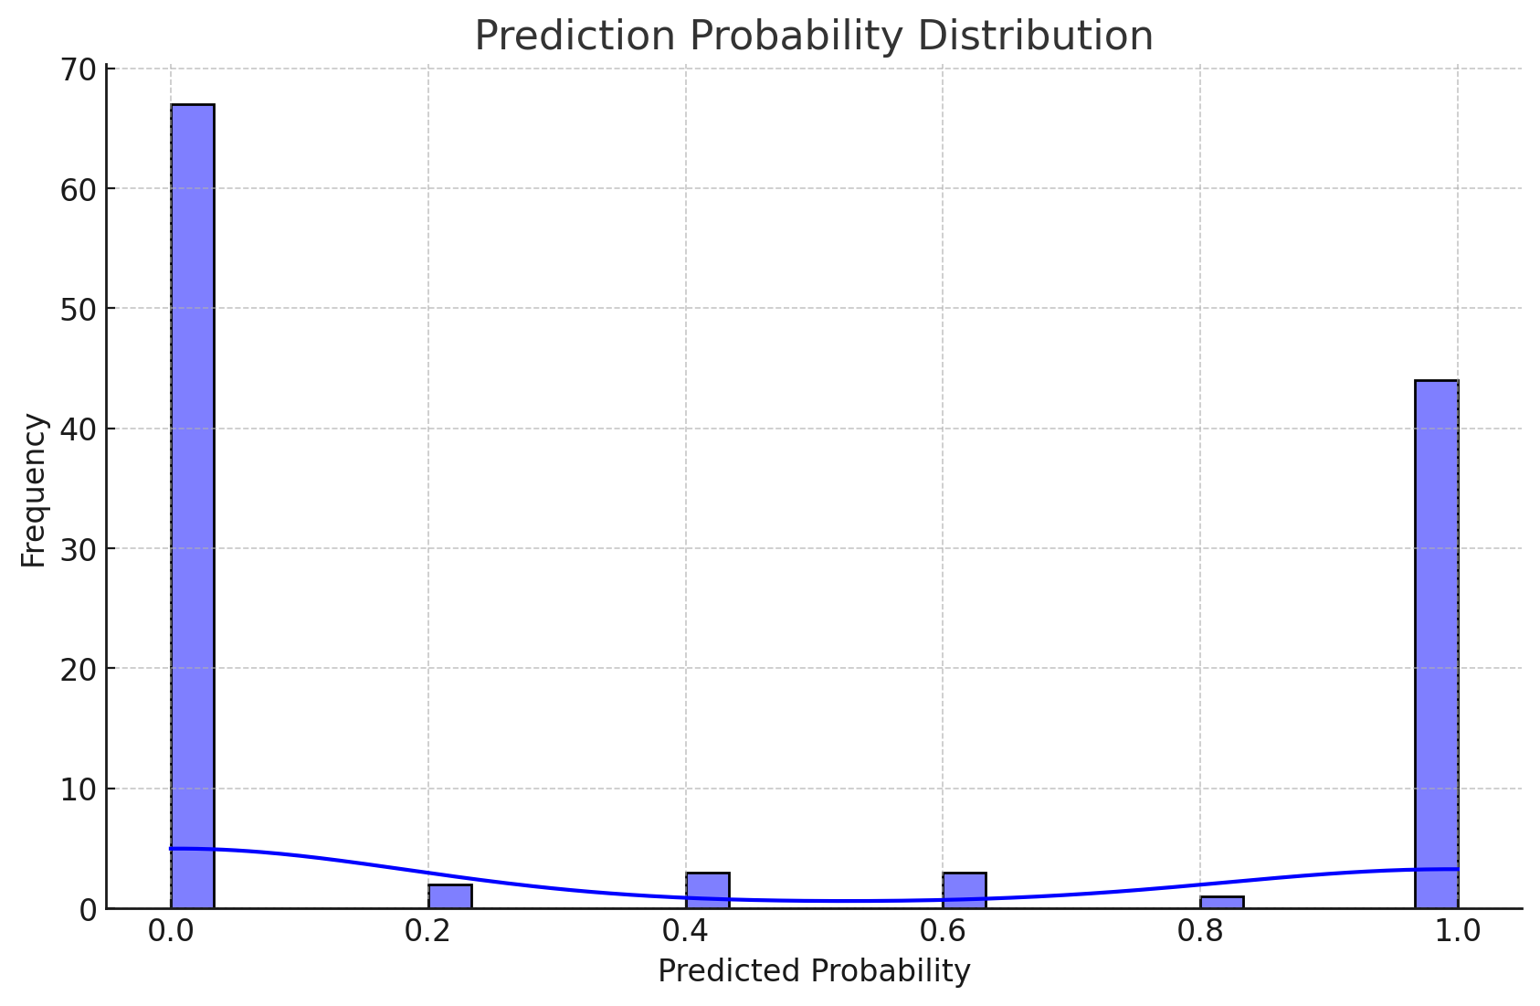
Model Performance
Prediction Probability Distribution
ROC Curve

Slide 20
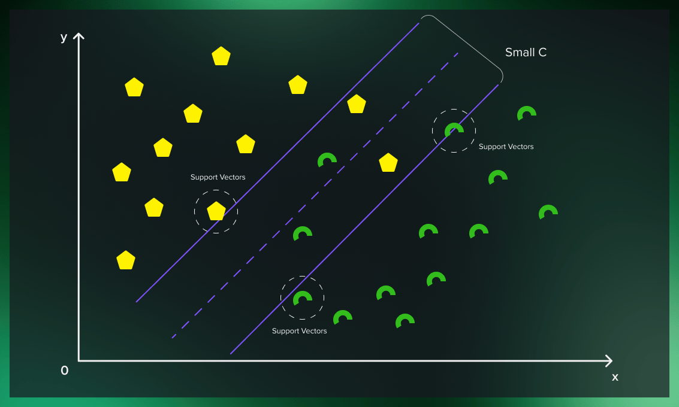
Algorithm-3
Support Vector Machine
(SVM)

Slide 21

General Overview
Support Vector Machine (SVM) Model for Detection of Chronic Kidney Disease (CKD)
Process Flow:
Data Preprocessing
Feature Selection
Model Training
Hyperparameter Tuning
Evaluation and Deployment

Slide 22
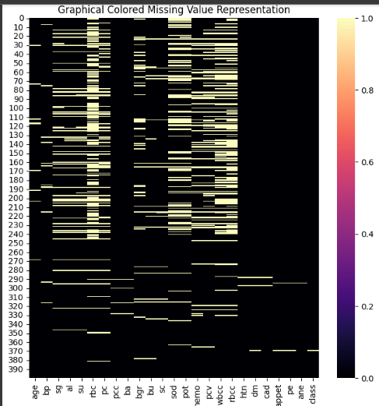
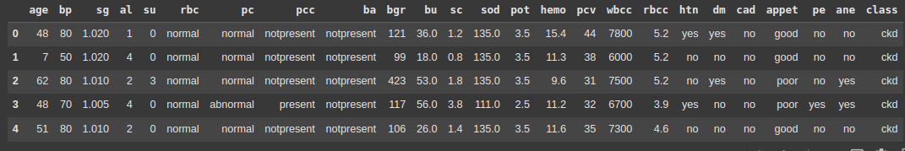
Data Preprocessing
Dataset
Data Cleaning
The dataset used for this model, retrieved from the UC Irvine Machine Learning Repository, consists of 400 rows and 24 features, with 1 target variable.
Since the dataset contains empty values and outliers, missing values were handled appropriately, redundant columns were removed, and categorical features were encoded using Label Encoder. Outliers in numerical features were addressed using the IQR method.

Slide 23
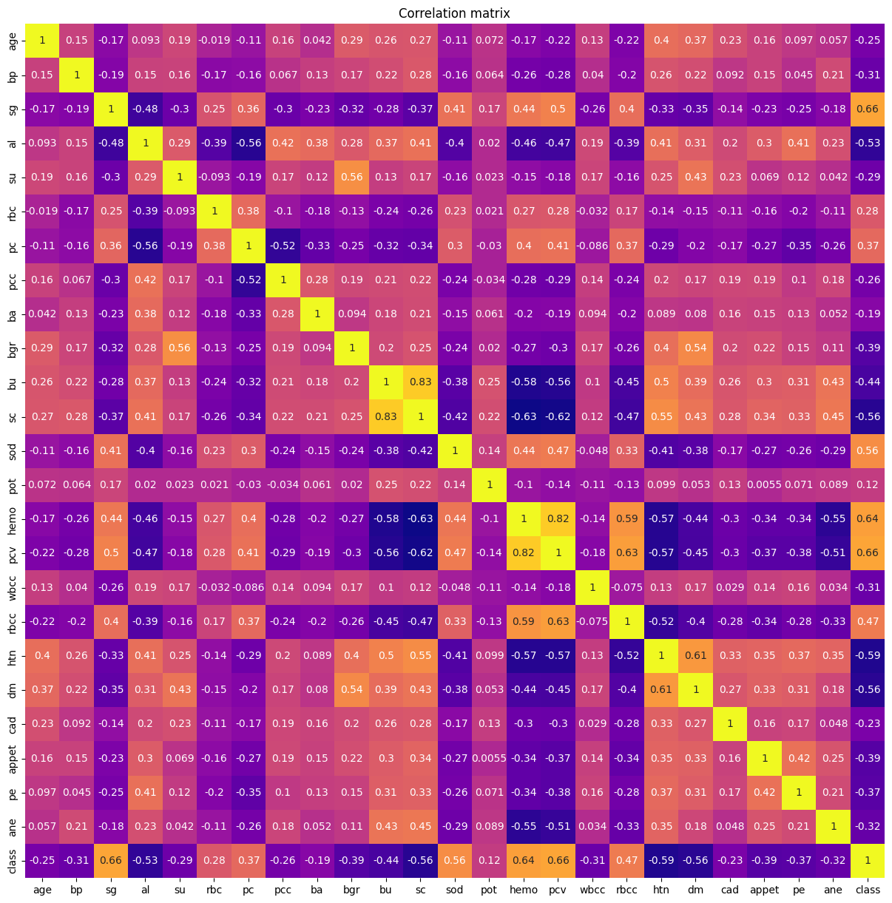
Feature Selection and Model Development
Feature Selection
Based on the correlation values of features with the CKD variable ≥ 0.29.
Model: Support Vector Machine (SVM)
In the code used for detecting CKD, an SVM model with a polynomial kernel is trained using 80% of the dataset, with features scaled using MinMaxScaler. The model's accuracy is evaluated on the test set, providing insights into its performance for CKD classification.

Slide 24
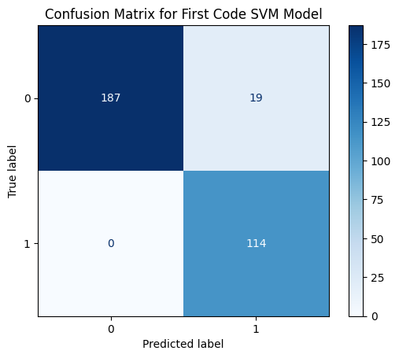
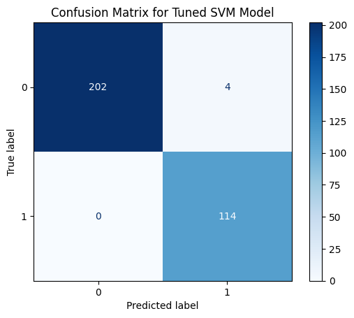
Model Evaluation
VS
Initial SVM Model Accuracy: 94.06%
Optimized SVM Model Accuracy: 98.75%

Slide 25
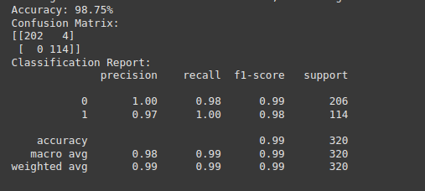
Best Hyperparameters for SVM Model
Key Hyperparameters for SVM:
C (Regularization Parameter): 0.1
Controls the trade-off between achieving low training error and minimizing model complexity.
A lower value (like 0.1) allows a simpler model, reducing the risk of overfitting.
Gamma (Kernel Coefficient): 0.1
Defines the influence of individual training examples in feature space.
A lower gamma (like 0.1) means each support vector has a larger impact on the model, preventing overfitting.
Kernel: 'rbf' (Radial Basis Function)
A commonly used kernel for SVM, useful for non-linear decision boundaries.
The RBF kernel can map input features into a higher-dimensional space where a linear decision boundary is sufficient.

Slide 26
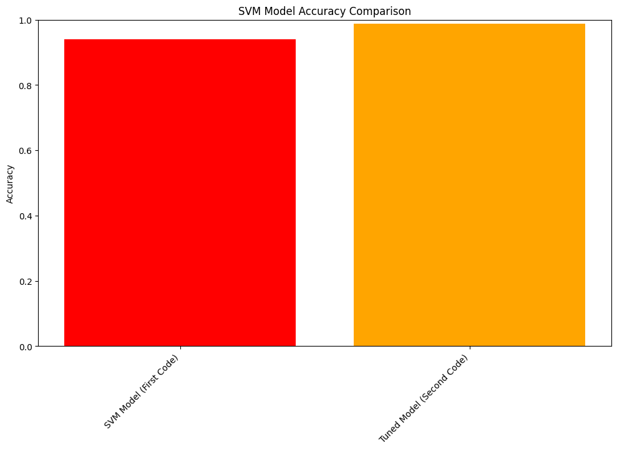
Key Insights and Final Takeaways
Approach
Achieved enhanced accuracy through hyperparameter tuning with the SVM model.
Successfully saved the optimized model for deployment as svm_model_tuned.pkl.
The fine-tuned SVM model delivers reliable predictions for CKD detection.
Next Steps
The model can be improved by exploring additional datasets, optimizing for real-time predictions, and extending its applicability to other diseases. Further research into model explain-ability and integration into healthcare systems could enhance its impact.

Slide 27
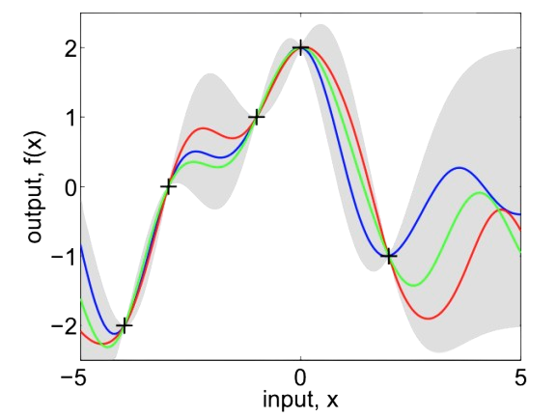
Algorithm-4
Gaussian Process Regression

Slide 28
What is Gaussian Process Regression Algorithm?
Gaussian Process Regression (GPR) is a powerful, non-parametric machine learning algorithm used for regression tasks.
It models a distribution over possible functions that fit the data, rather than relying on a specific functional form.
Instead of using any predefined function the GPR models the data by Gaussian Process by collecting random variables at finite number of points.
Time series prediction
Geospatial data modelling
Machine learning in robotics
optimization problems
Applications

Slide 29
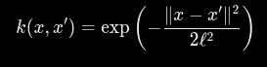
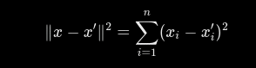
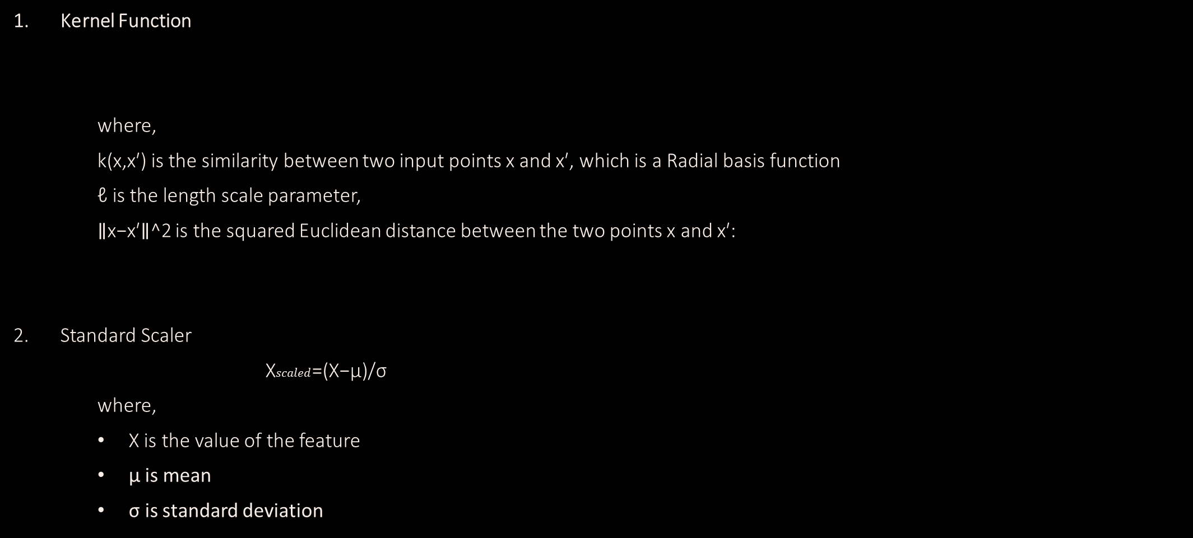
How it Works?
Kernel Function
where,
k(x,x′) is the similarity between two input points x and x′, which is a Radial basis function
ℓ is the length scale parameter,
∥x−x′∥^2 is the squared Euclidean distance between the two points x and x′:
Standard Scaler
X$scaled$​=(X−μ)/σ​
where,
X is the value of the feature
μ is mean
σ is standard deviation

Slide 30
GPR Implementation
1. Data Preprocessing:
- Handled missing values.
- Scaled the features for uniformity.
-Normalizes the data using Standard Scaler.
2. Model Training:
- Splitting the data into 50% training and 50% testing sets.
3. Model Evaluation:
- Computing the accuracy score.
- Displaying a confusion matrix.

Slide 31
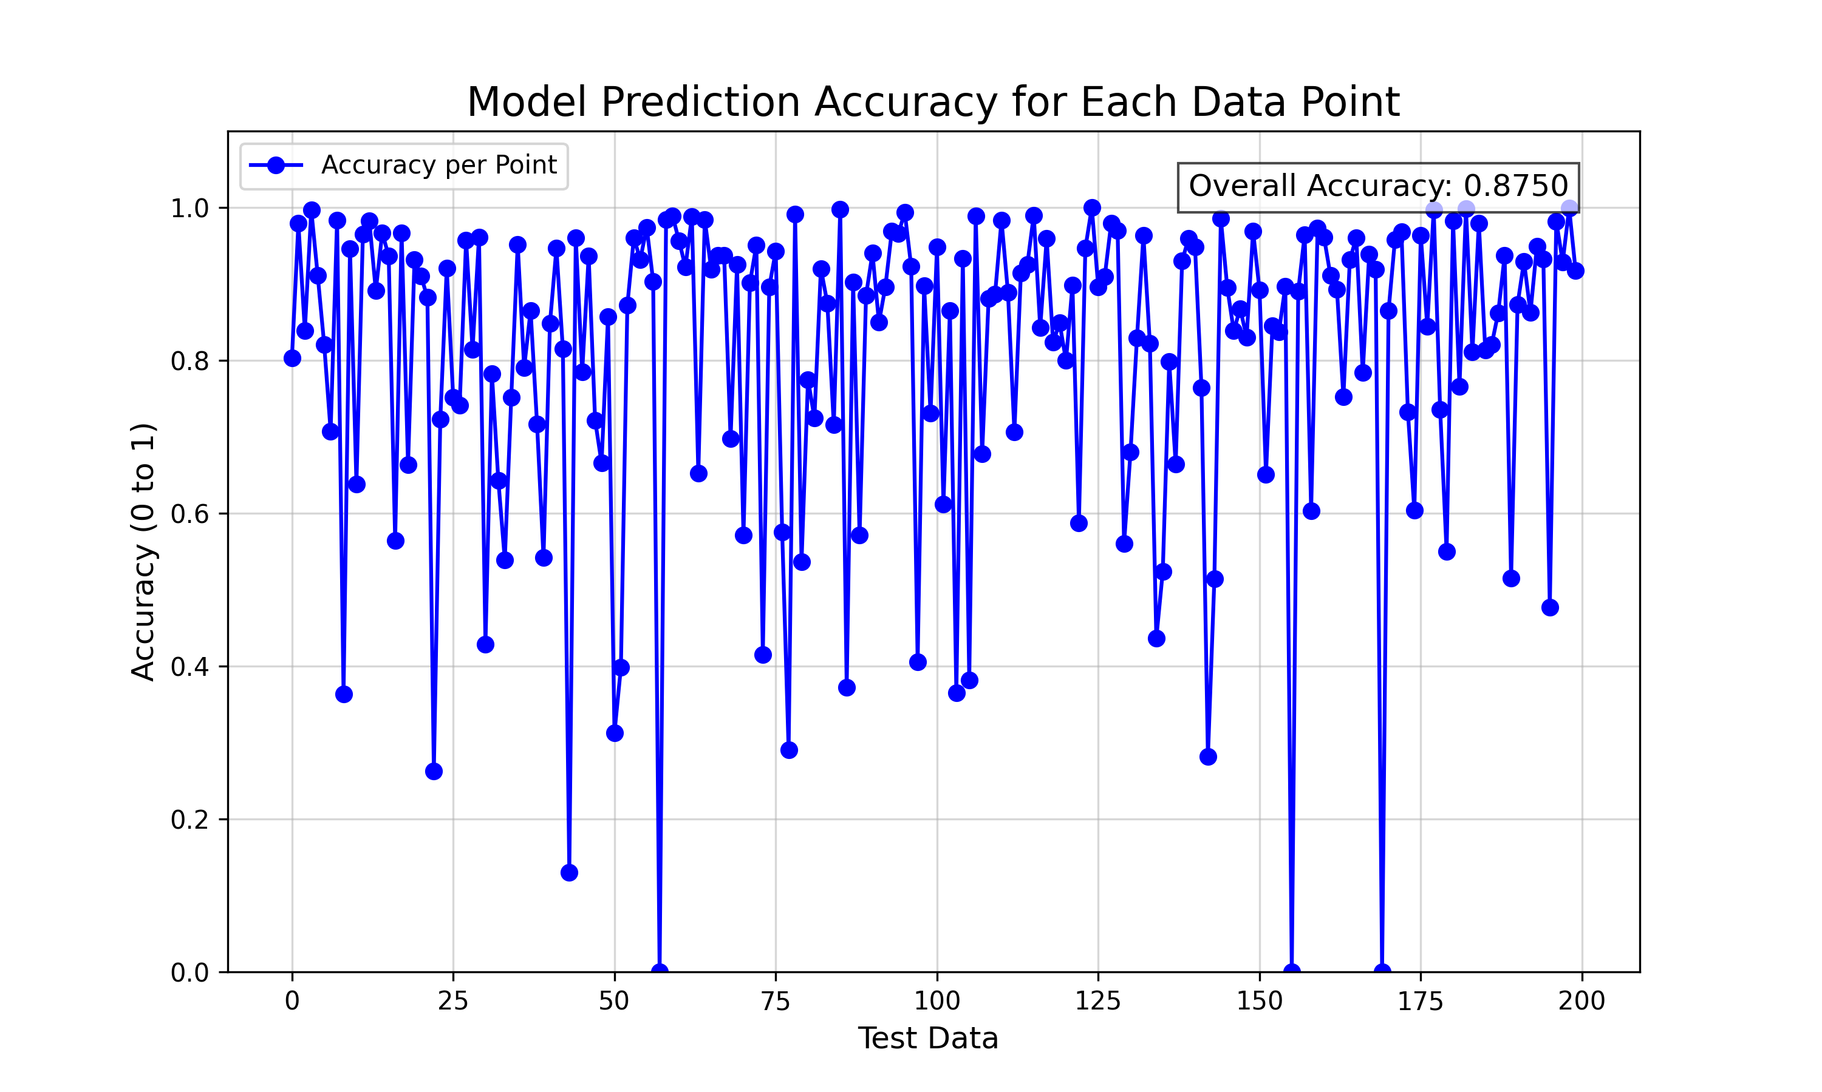
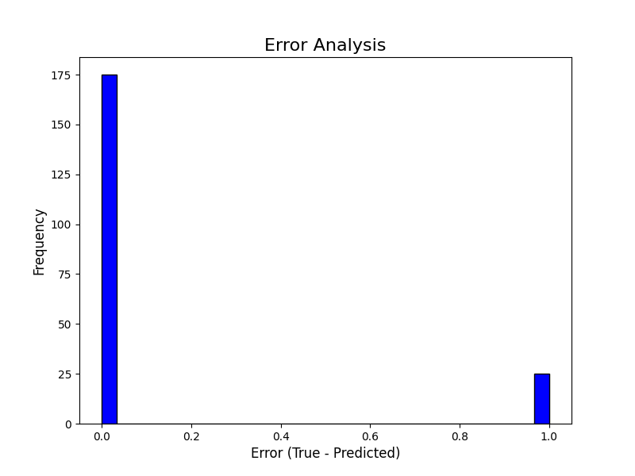
Model Performance
Accuracy : 0.8750
Error Analysis

Slide 32
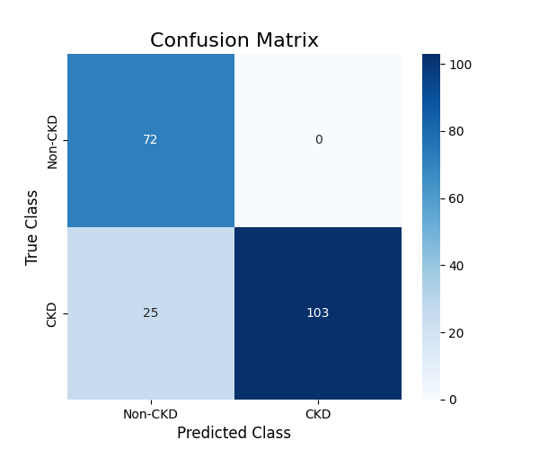
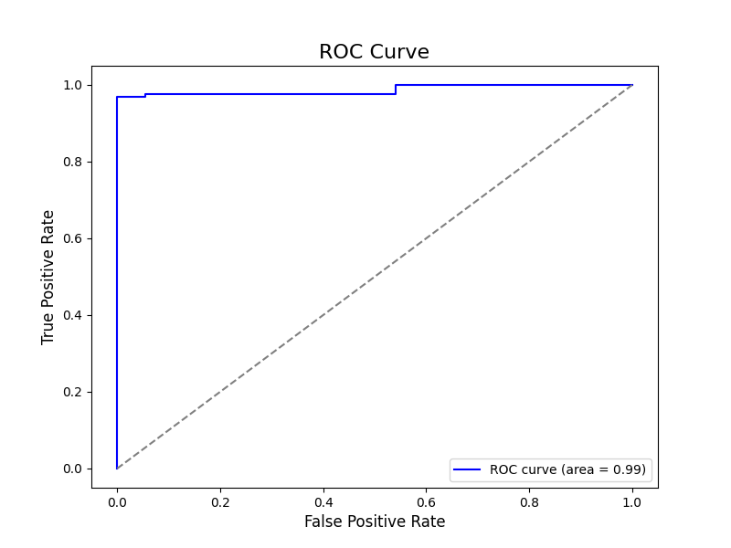
Model Performance
Confusion Matrix
ROC Curve

Slide 33
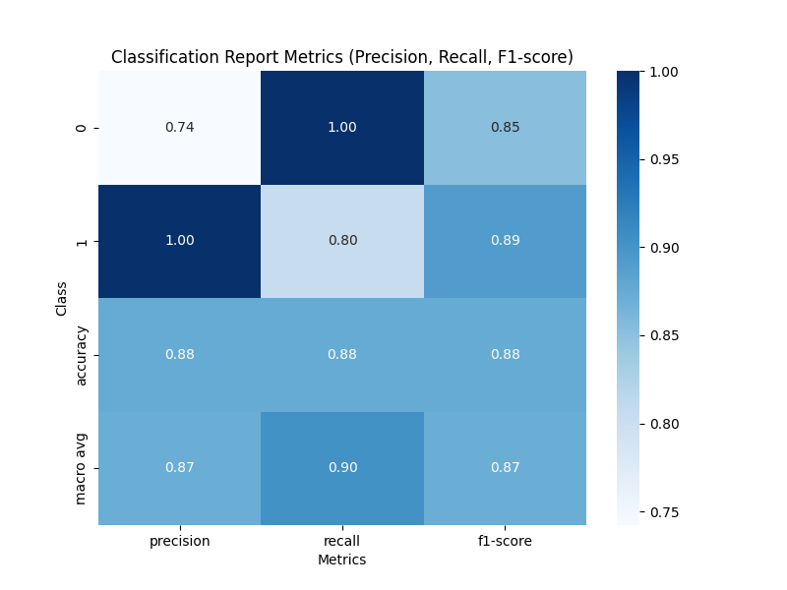
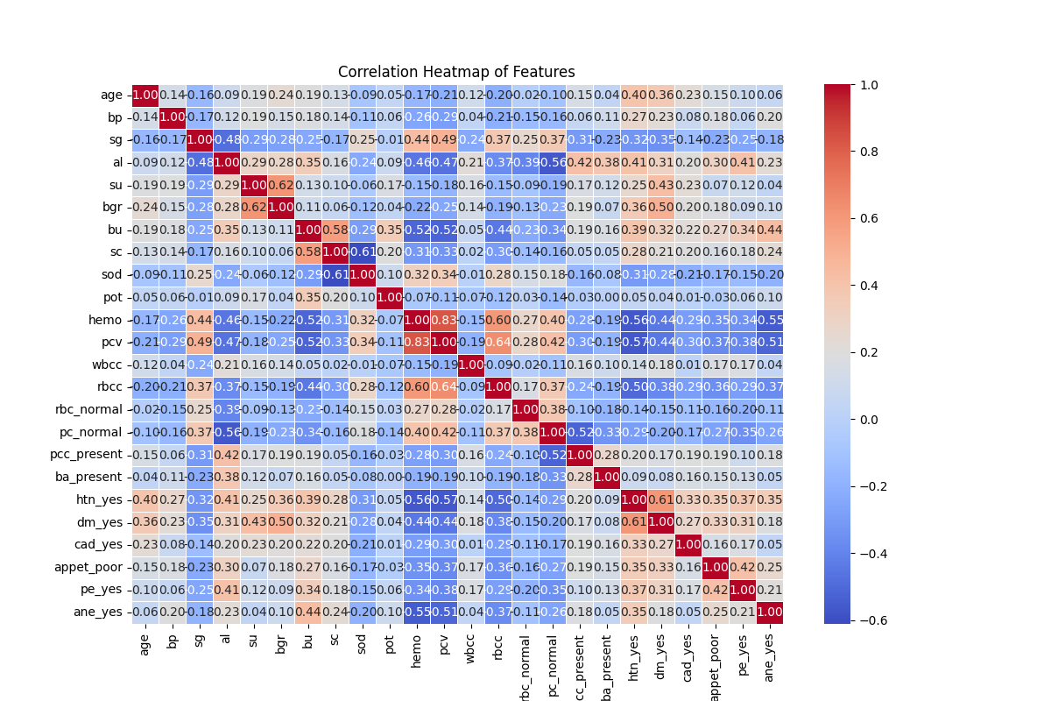
Model Performance
Classification Report
Co-relation Heat Map

Slide 34
ROC Calculations
True Positive Rate
False Positive Rate
The proportion of actual positive cases that are correctly identified by the model.
(TP)
(TP+FN)
The proportion of actual positive cases that are correctly identified by the model
(FP)
(FP+TN)
FPR =
TPR =

Slide 35
Comparison of All Model Performance Metrics
Accuracy
Precision
The proportion of correctly classified instances.
(TP+TN)
(TP+TN+FP+FN)
The proportion of true positives among predicted positives.
TP
(TP+FP)
Accuracy =
Precision =
Recall (Sensitivity)
F1-score
The proportion of true positives among actual positives.
TP
(FN+TP)
The harmonic mean of precision and recall.
2*Precision*Recall
Precision + Recall
F1-score =
Recall =

Slide 36
Comparison of Model Performances
S.N | MODEL ALGORITHM | ACCURACY
1. | LOGICAL REGRESSION | 96.56 %
2. | K-NEAREST NEIGHBORS | 92 %
3. | SUPPORT VECTOR MACHINE | 94.05 %
4. | GAUSSIAN PROCESS REGRESSION | 87.50 %

Slide 37

Conclusion
Algorithms:
Logistic Regression
K-Nearest Neighbors (KNN)
Support Vector Machines (SVM)
Gaussian Process Regression (GPR)
Get the models and all the codes and results at:
https://bit.ly/ibd-ckd
Or,
Scan this QR Code
Key Takeaways:
SVM and GPR are effective for capturing complex relationships in data.
KNN is simple, flexible, and works well for smaller datasets.
Logistic Regression is interpretable and useful for binary classification tasks.
These algorithms collectively offer diverse strengths for accurate CKD prediction.

Slide 38
References
Data Set : https://doi.org/10.24432/C5G020

